Slide 1
Data Analytics – NYC Flight Data
Author : Manoj B

Slide 2
Dataset Description
Contains flights info in the year 2013
Total no of flights = 336,776
Source airports provided = EWR, JFK and LGA
Destinations = 105 airports
Total carriers =16

Slide 3
Data cleaning
The 4 time variables in the dataset are in numerical format, so converted into date time format.
Among 336,776 flights,328521 have the departure time and the rest 8255 are being assumed as cancelled.
Among 328521 few variables given below have missing data. So, the missing value treatment is being applied based on below formula.
Arrival time = scheduled arrival time + departure delay
Arrival Delay = Arrival time - Scheduled arrival time
Air time = Arrival time - Departure time

Slide 4
Data Cleaning
Removed the constant/unwanted columns like year, tailnum etc. since these do not signify anything for our analysis
Applied Pandas Profiling on the dataset and based on the correlation matrix ignored few other columns that are highly correlated (i.e. considered one among them)

Slide 5
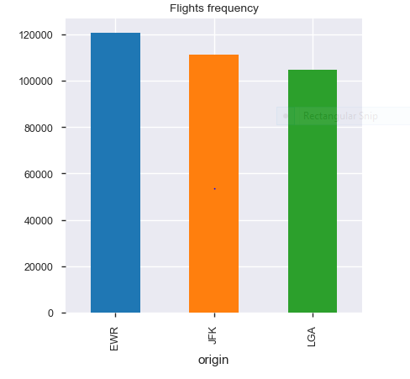
1. No of departures from each airport

Slide 6
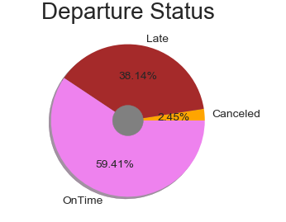
Departures Analysis

Slide 7
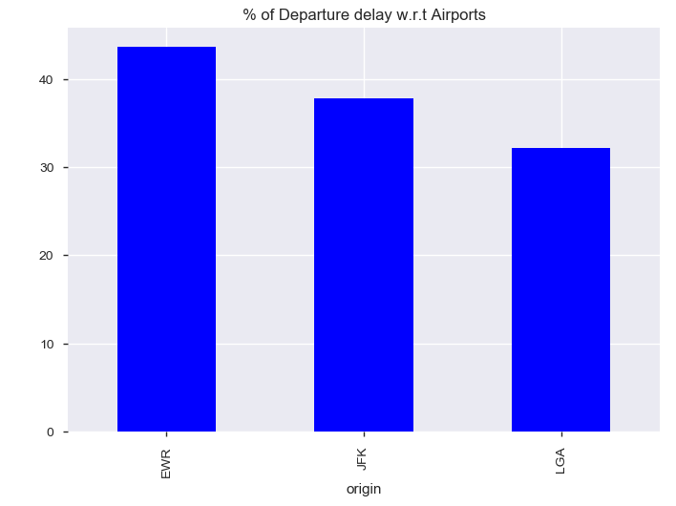
Departure Delay LGA is best airport with 32% of flights departured late and EWR has recorded worst percentage 43.6% in 2013

Slide 8
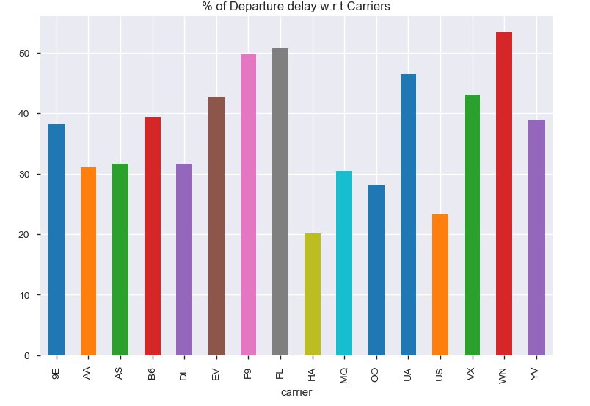
Departure Delay Carrier HA has lowest departure delay of 20%

Slide 9
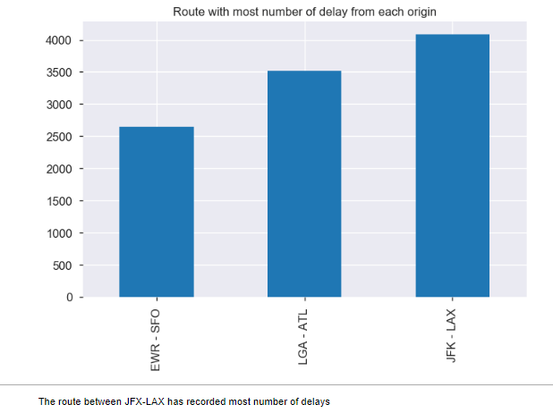
Departure delay

Slide 10
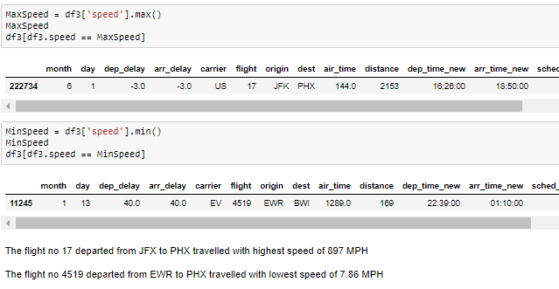
Aircraft Speed Analysis

Slide 11
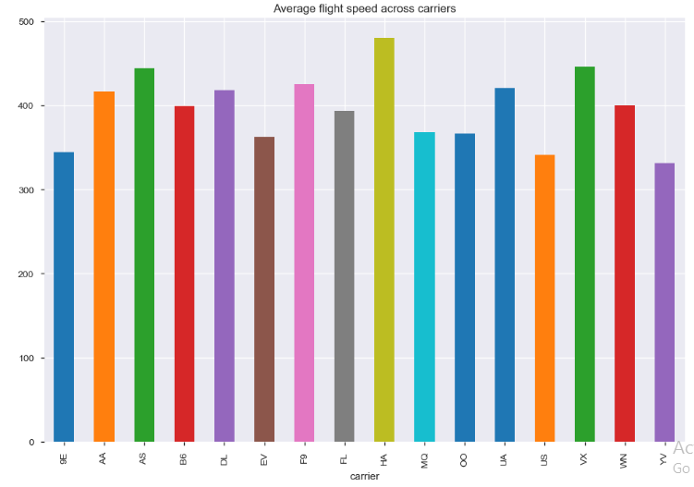
Aircraft Speed Analysis Carrier HA is the best in terms of Speed

Slide 12
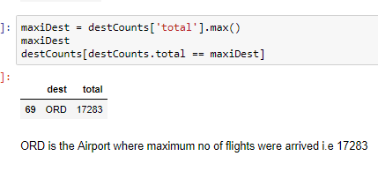
Maximum number of flights headed to some particular destination

Slide 13
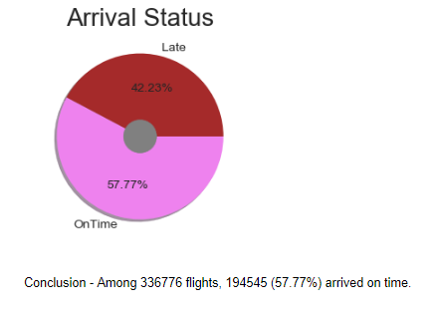
On Time Arrival Analysis

Slide 14
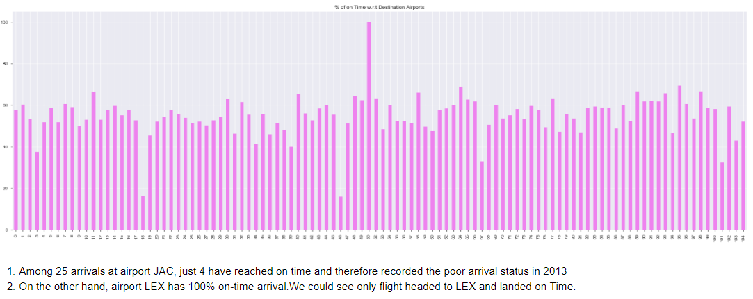
On Time Arrival Analysis - Best Airports with respect to On time Arrivals

Slide 15
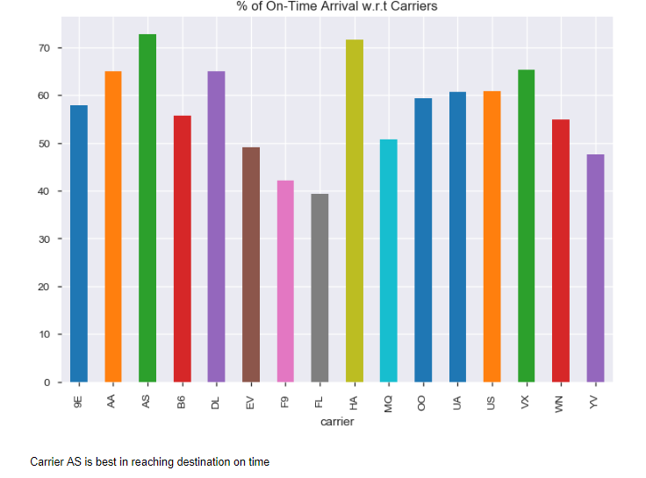
On time Arrival - Carriers

Slide 16
Thank you

